Slide 1
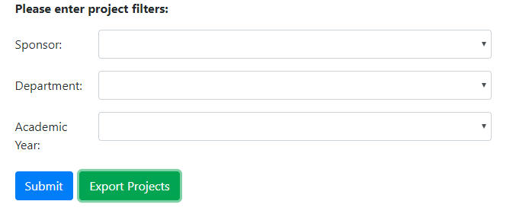
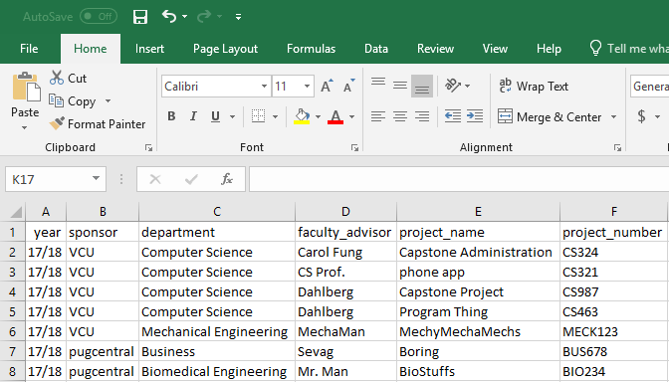





[324]
Capstone Administration
Team members: Matthew Lesniewicz, Shaun Graham | Faculty adviser: Dr. Robert Dahlberg | Sponsor: VCU | Mentor: Dr. Ben Ward
Introduction
Application Screenshots
Solution
A solution was needed to resolve the growing difficulty of coordinating information for capstone projects.
Previously spreadsheets were passed around within VCU and to the various sponsors. The information in these spreadsheets quickly became outdated and would have to be resent to all other parties whenever a change was made.
The Capstone Administration Project was created to allow easier management of the senior design projects and also to make sharing the data easier and more reliable.
Designed and implemented a MySQL database as a central location for information on all the Capstone Projects to be stored.
Designed and implemented a website that allows the end user to view and edit the information stored in the database, as well as share read-only access with other users.
Technologies
Reasoning
Using an application like google sheets would not have solved the problem sufficiently.
The senior design projects over many years must also be kept along with sponsors and their contact information. Sponsors often persist between years, and need to be retained.
To allow the easy filtering of information we had to create a database. When the user filters information they are also able to download custom spreadsheets.

